Slide 1
2022-09-08
Food energy is amazing
Energy vs power
Energy Examples: Thermal, Kinetic, Gravitational

Slide 2









What are some types of energy?
Type Example How you know it’s there
Notes:
Let’s do some applied examples in several of these types.

Slide 3
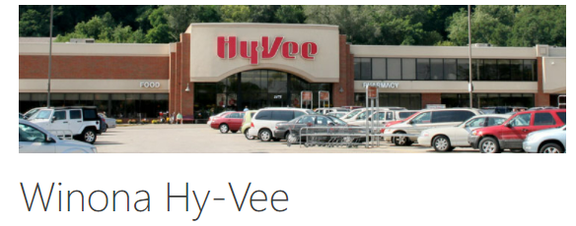
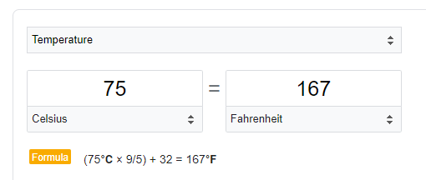














Reminder, 3000kcals at the HyVee Grand Buffet is enough energy to heat your body up to 167F
Notes:
It takes about 80kcals to raise an 80kg (176lbs) person’s body temperature 1C (+1.8F)
3000kcals spread out over 80kg of person increases temperature by 37.5C if immediately burned
This raises body temp to 75C (167F) which is obviously wrong
Fat tissue is awesome!

Slide 4

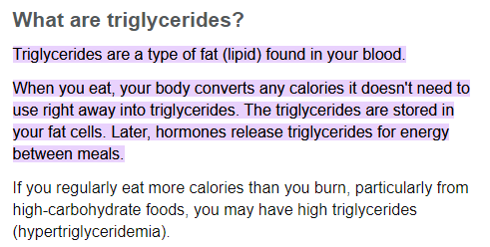












What happens to that food energy? Bar Charts
Notes:
Food > blood sugar > Fat tissue > Sugar > muscles > climb a hill
https://www.mayoclinic.org/diseases-conditions/high-blood-cholesterol/in-depth/triglycerides/art-20048186
https://www.verywellhealth.com/what-foods-cause-high-triglycerides-1087467

Slide 5





What happens to that food energy? Bar Charts
Notes:
Food > blood sugar > Fat tissue > Sugar > muscles > climb a hill
https://www.mayoclinic.org/diseases-conditions/high-blood-cholesterol/in-depth/triglycerides/art-20048186
https://www.verywellhealth.com/what-foods-cause-high-triglycerides-1087467

Slide 6
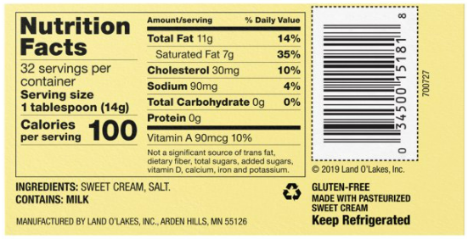

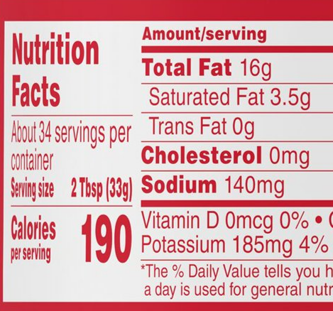


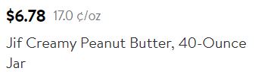





Where does the energy go? Power
Notes:
If you eat 3000kcals/day (and you don’t gain weight) that energy is released as body heat (1 Watt = 1Joule/second and 1 kcal = 4180 Joules).
1 lb of butter per day, or 20oz of peanut butter per day?

Slide 7
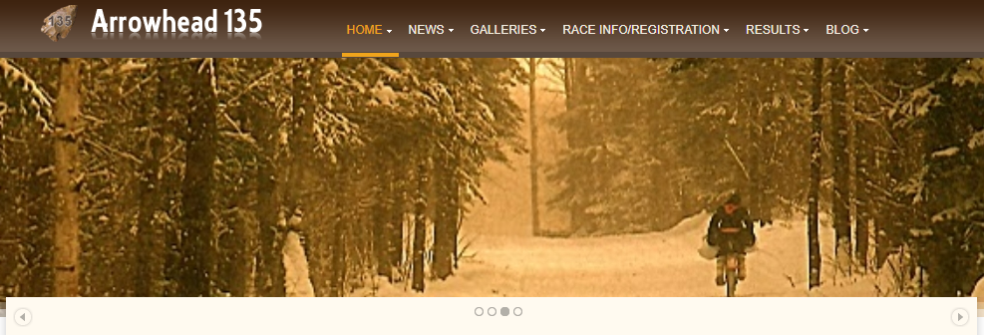
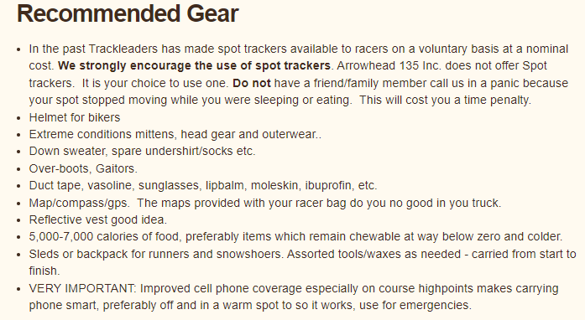
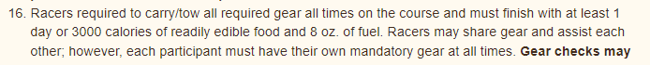
A jar of peanut butter is not a joke!
Notes:
International Falls to Tower MN. 135 miles, Jan 31-Feb 2: 7am Monday to 7pm Wednesday
http://www.arrowheadultra.com/

Slide 8
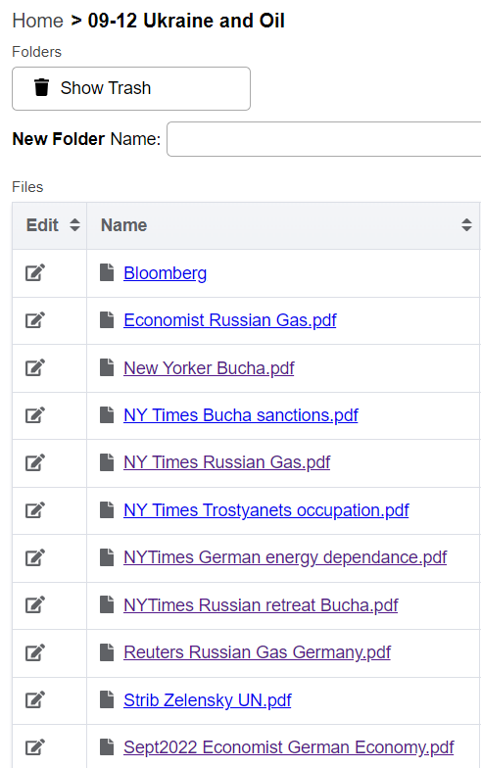
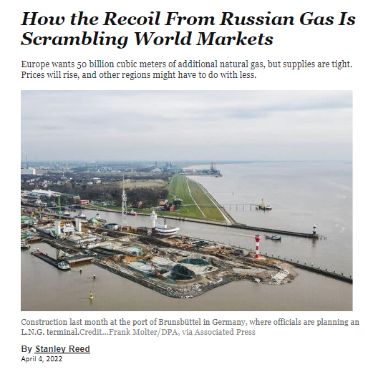
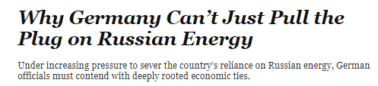
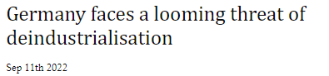
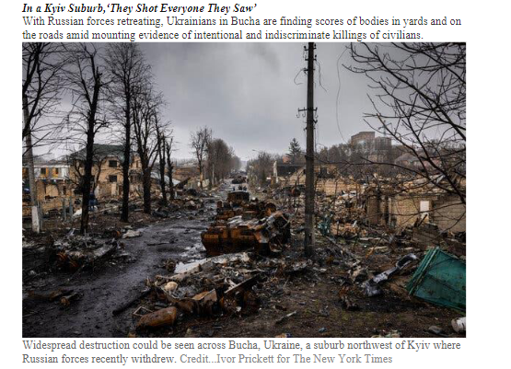

Start here 09-13
NB Readings for 09-12:
Why do people “get away with” atrocities in war?
Notes:
Germany is the 4th biggest economy in the world. Energy comes from Russia, mostly as Natural Gas. War has let Russia to cut off the flow of some gas, and the threat of further Russian production cuts has facilitated atrocities.

Slide 9
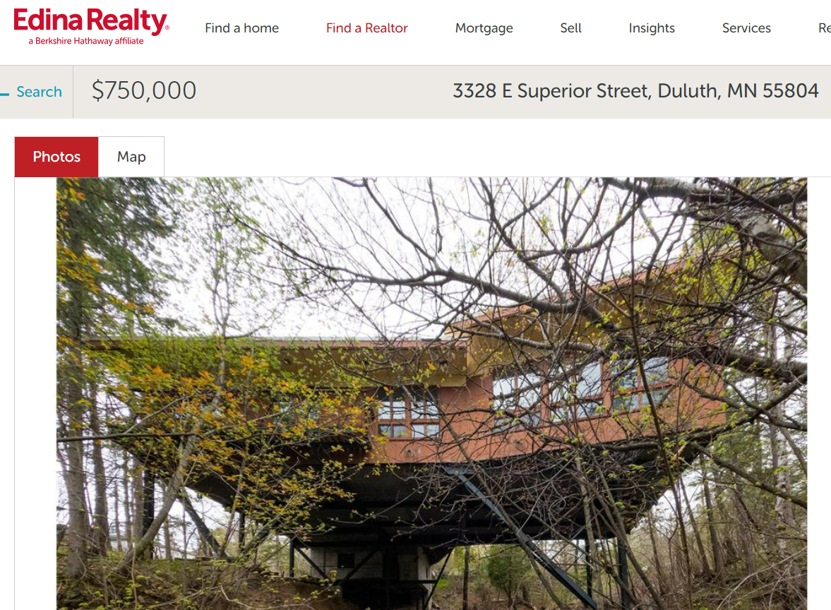
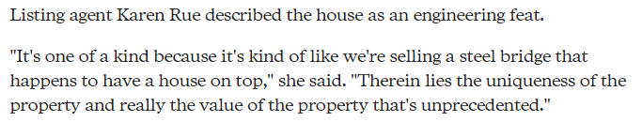
https://www.edinarealty.com/homes-for-sale/3328-e-superior-street-duluth-mn-55804-6150741

Slide 10
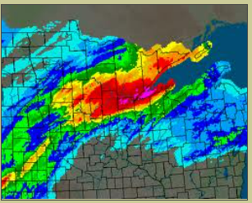
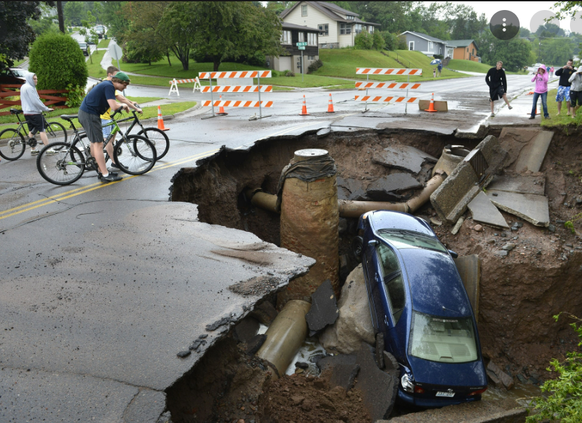
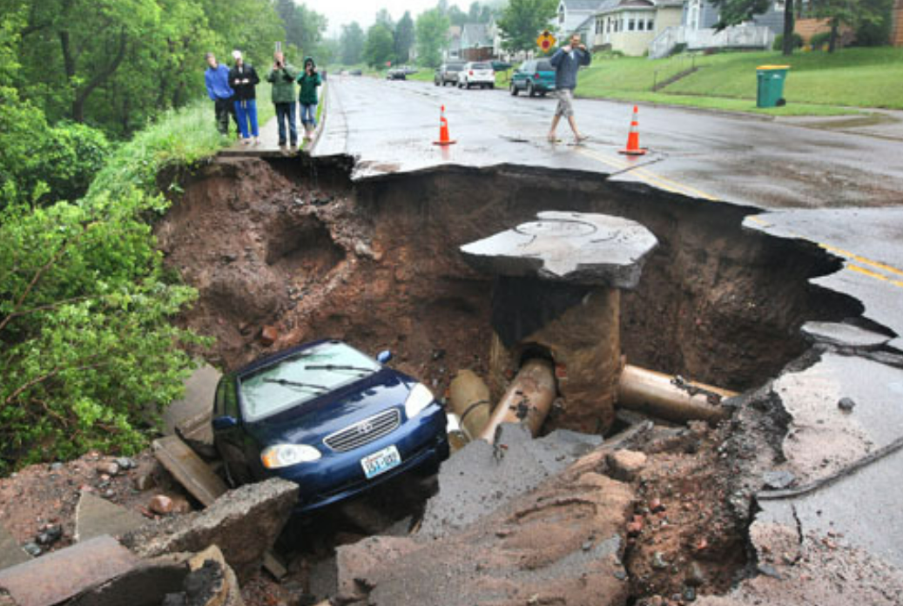
June 2012
5-10 inches of rain over ~2 day period
Notes:
https://www.weather.gov/dlh/june2012_duluth_flood

Slide 11
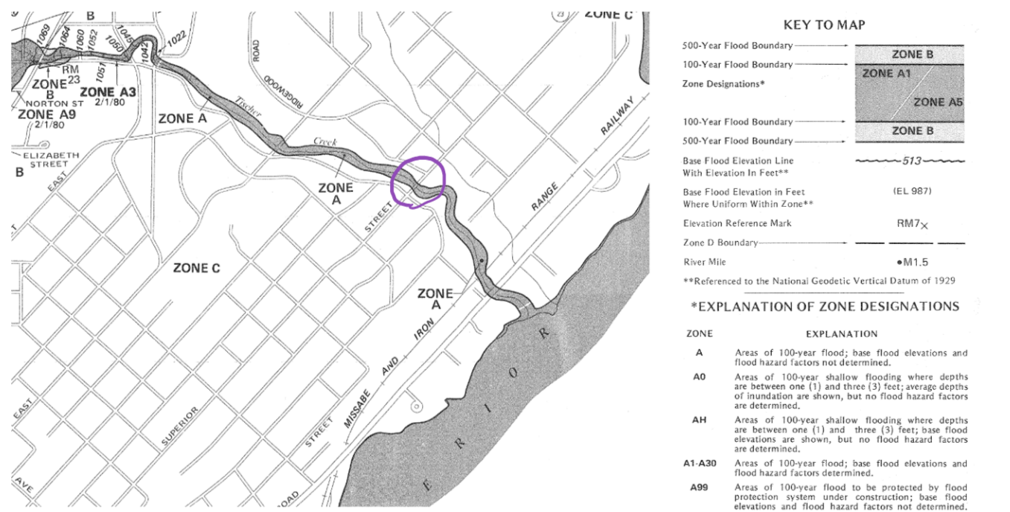
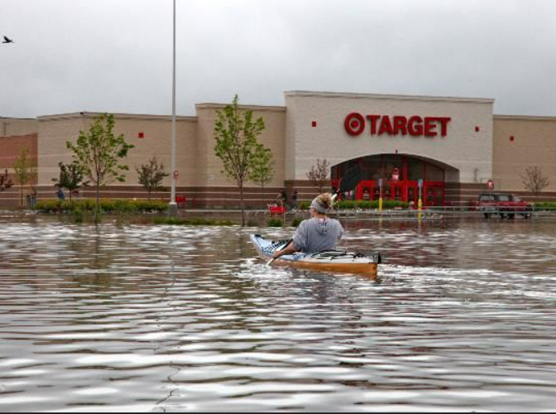
Notes:
https://www.fema.gov/flood-maps

Slide 12
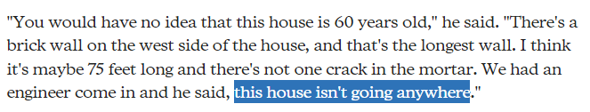
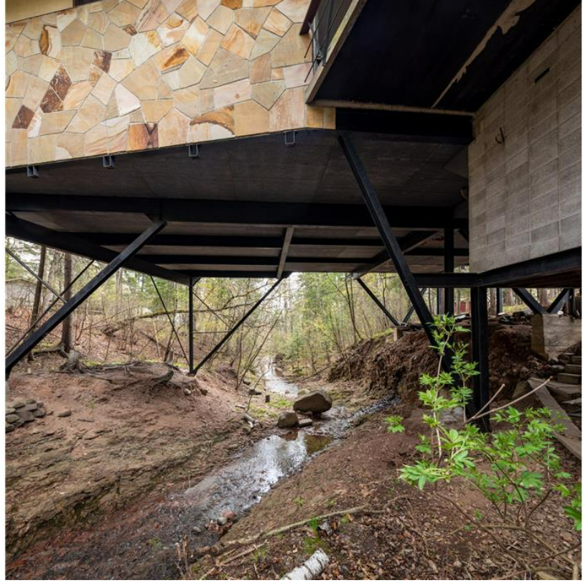
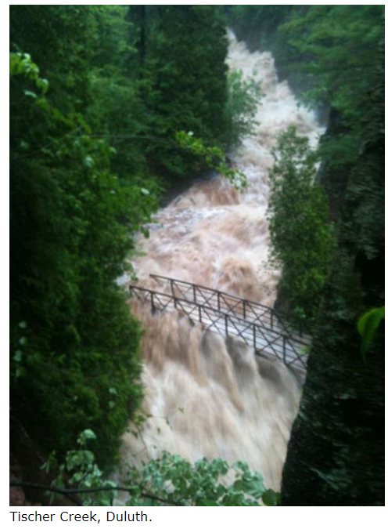
Notes:
https://www.startribune.com/duluths-creek-spanning-midcentury-modern-stilt-house-lists-for-750000/600205413/
https://www.lakesuperiorstreams.org/stormwater/flood/
https://mn.water.usgs.gov/flood/DuluthArea2012/

Slide 13
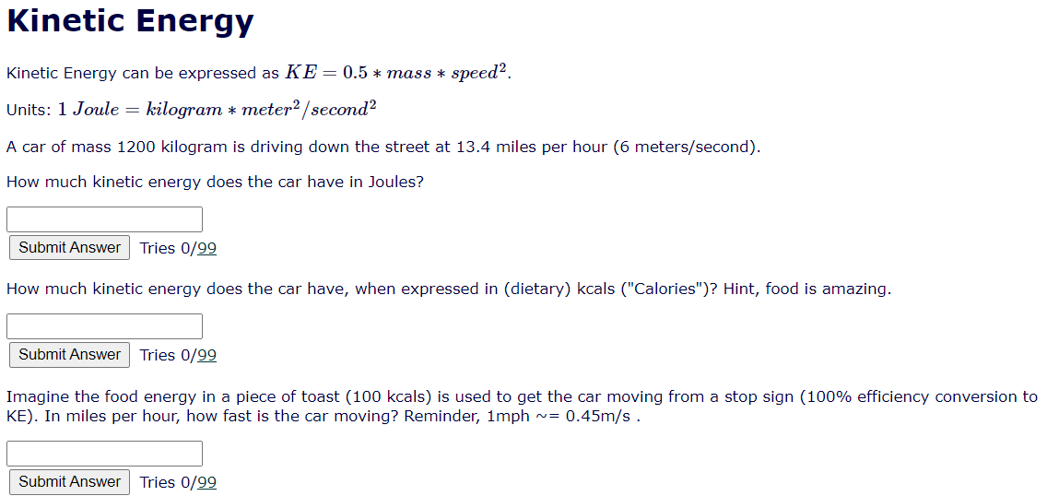














Slide 14









Slide 15
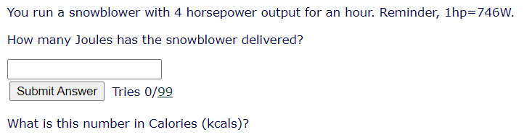


















Slide 16

























Slide 17
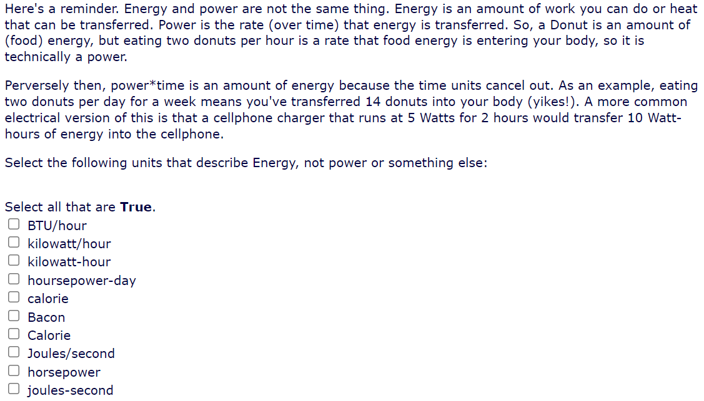




















Slide 18







































Slide 19
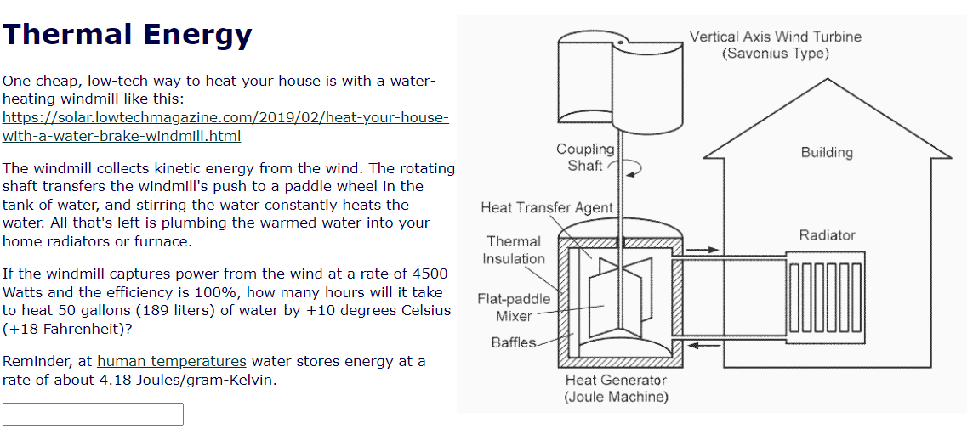






Slide 20
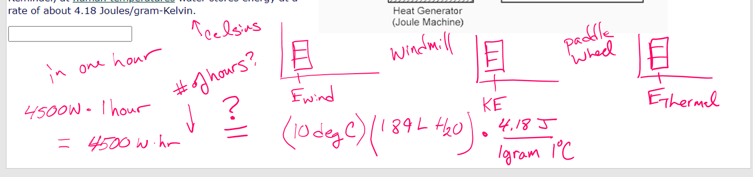
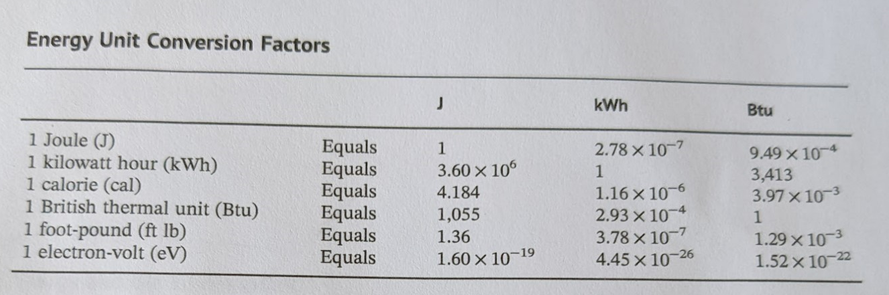










Slide 21





















Slide 22
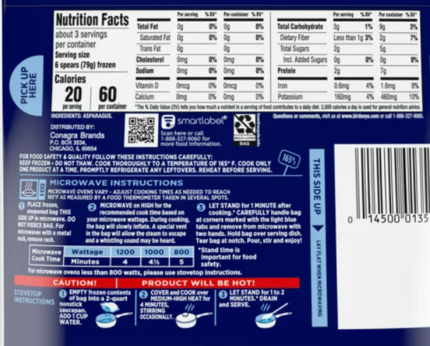
























Slide 23
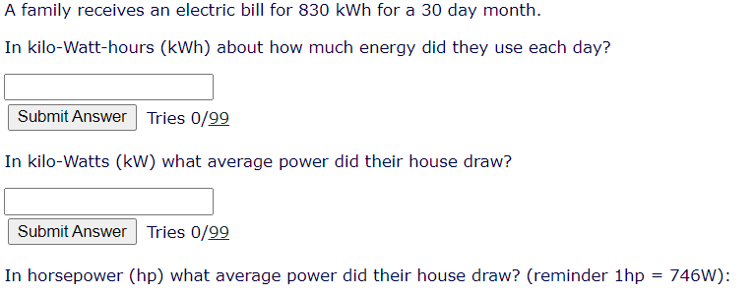













Slide 24
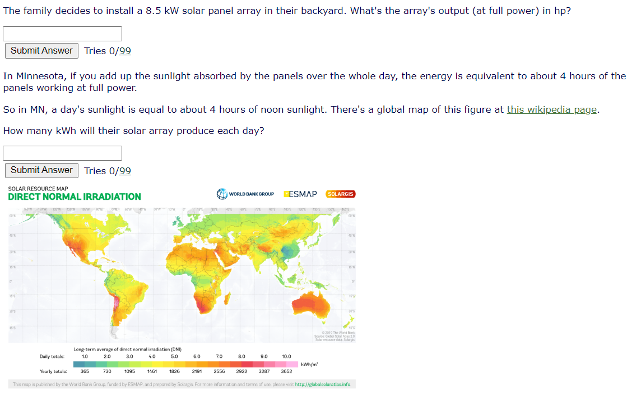




Slide 25
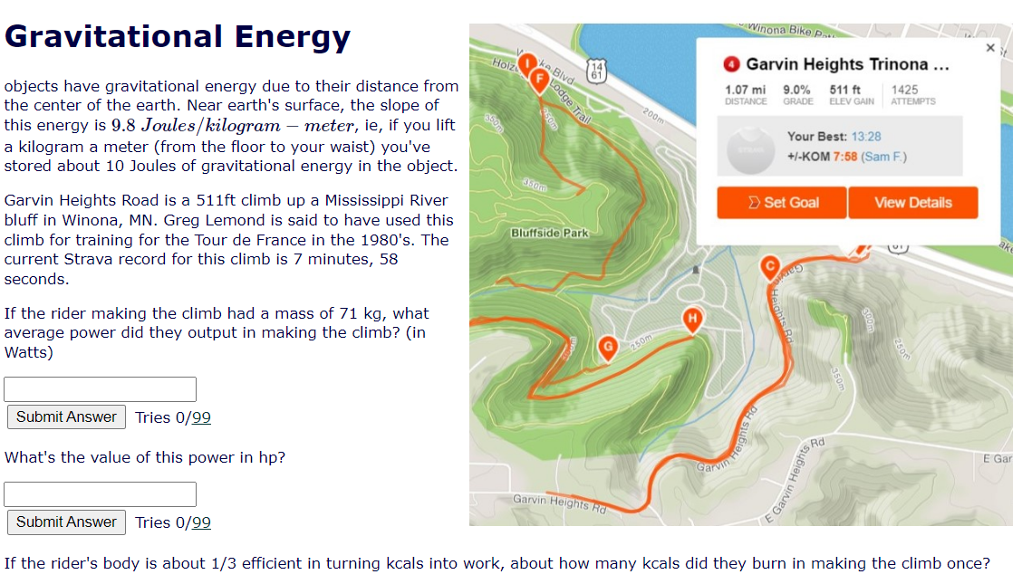













Slide 26



































Slide 27



















